Slide 1
Research Question
Which ad platform is more effective in terms of conversions, clicks, and overall cost-effectiveness?
Facebook

Slide 2
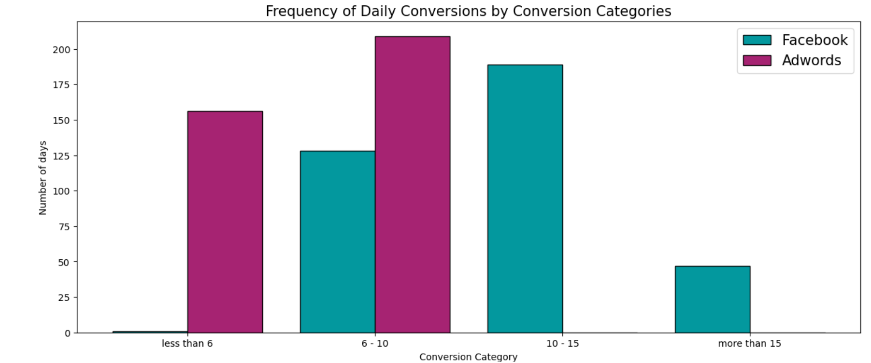
1. The data suggests Facebook had more frequent higher conversion days than AdWords, which either had very low conversion rates (less than 6) or moderate ones (6 - 10). 2. There is a significant variance in the number of high-conversion days between two different campaigns. 3. The absence of any days with conversions between 10 - 15 and more than 15 in AdWords indicates a need to review what strategies were changed or what external factors could have influenced these numbers.

Slide 3
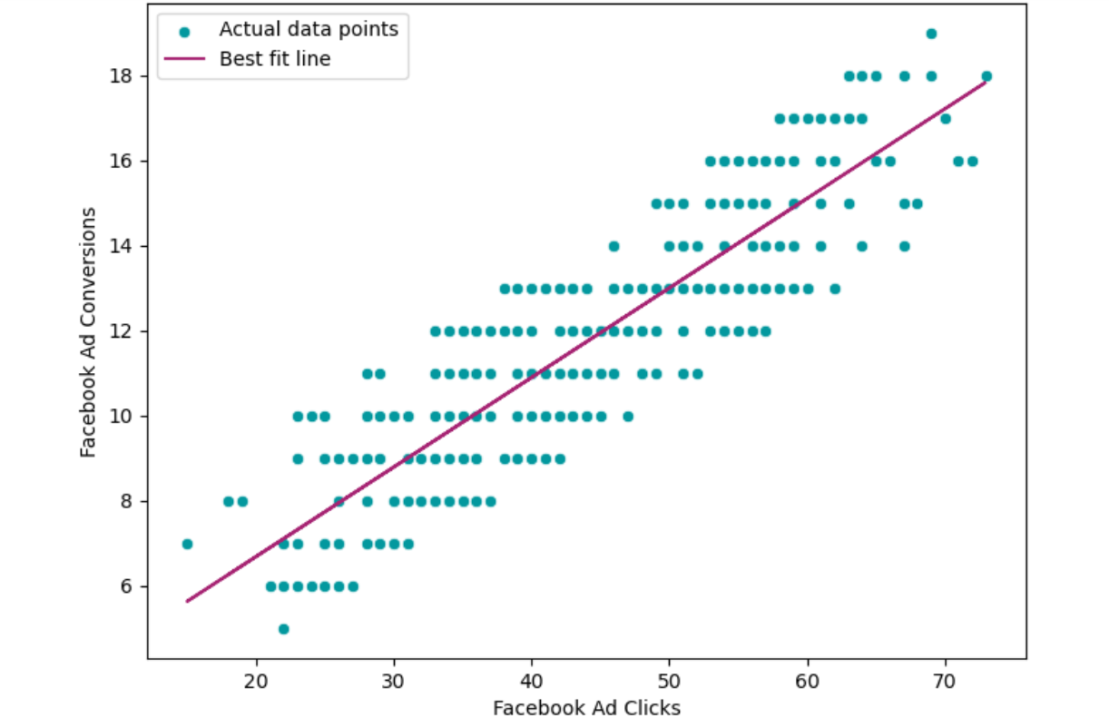
Regression Analysis What will happen when I do go with the Facebook Ad? How many facebook ad conversions can I expect given a certain number of facebook ad clicks?
For 50 Clicks, Expected Conversion : 13.0
For 80 Clicks, Expected Conversion : 19.31

Slide 4
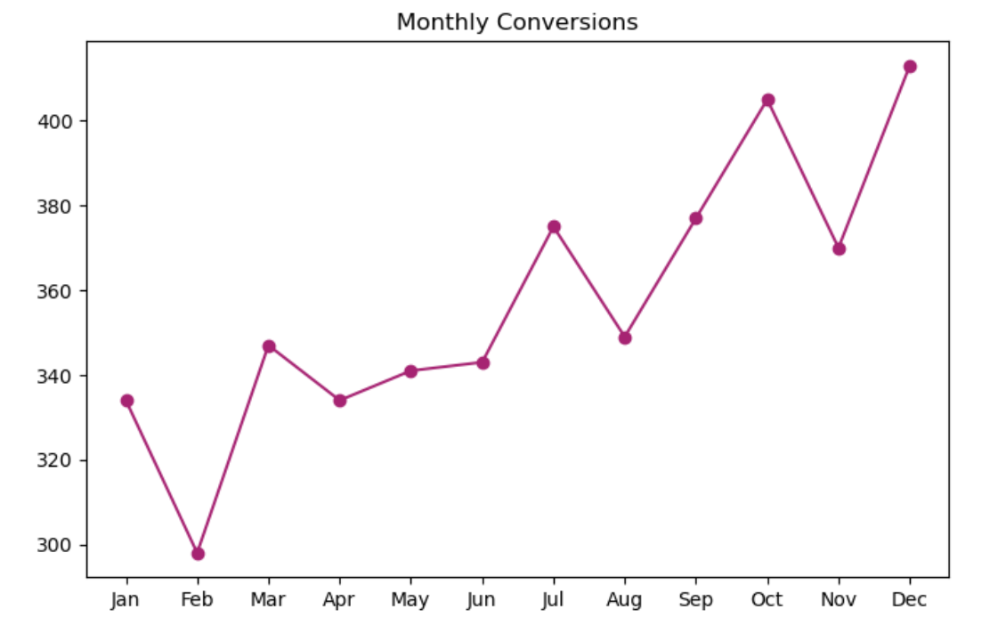
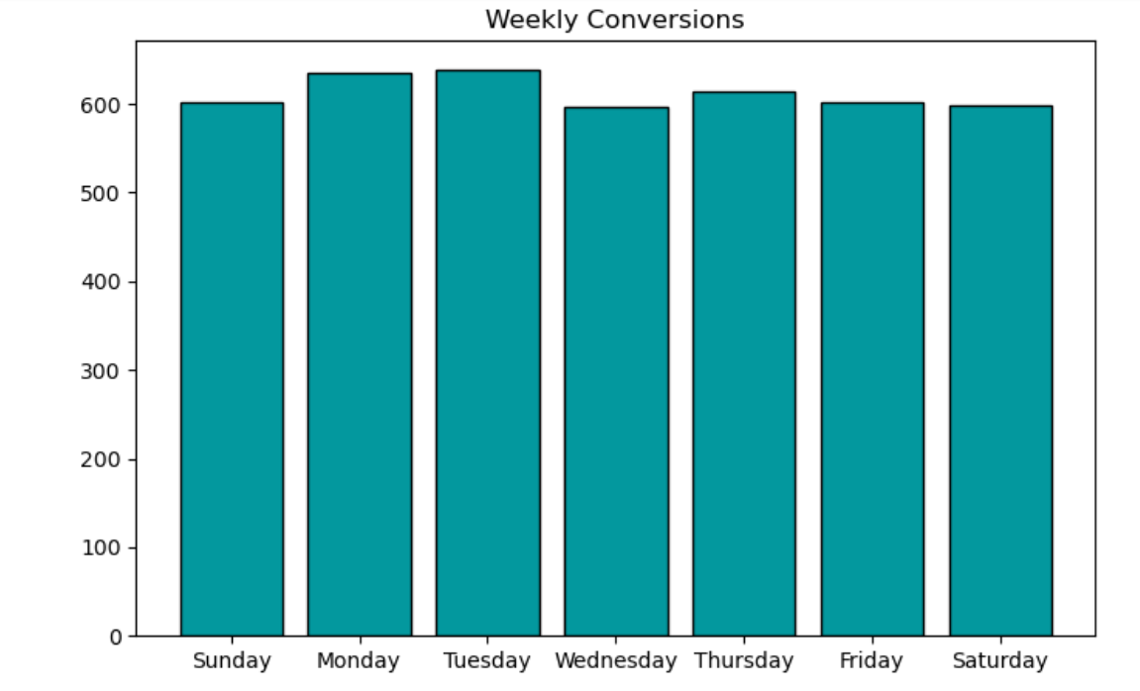
At what times of the month or days of the week do we observe the conversions?

Slide 5
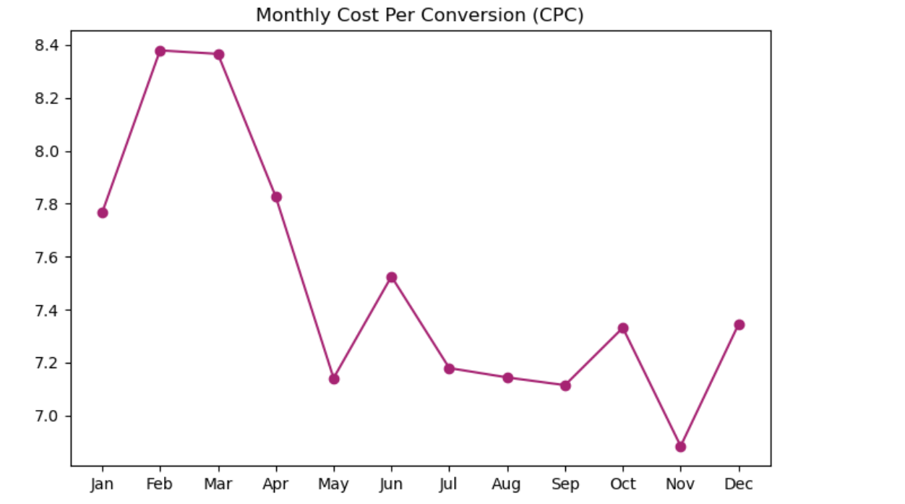
How does the Cost Per Conversion (CPC) trend over time?
May and November have the lowest CPC values, indicating potentially more cost-effective advertising or higher conversion rates during these periods.
Lower CPC values in certain months (e.g., May and November) could indicate periods of higher advertising effectiveness or more favorable market conditions.
Consider allocating more advertising budget to months with historically lower CPC values (e.g., May and November) to maximize ROI
The CPC trend over the 12-month period shows some fluctuations but overall maintains a relatively stable range

